Slide 1
Lesson objective
07/04/2022
Title: factorizing expressions
Aim:
To be able to factorize expressions into single brackets.
Plan:
Review like terms
HCF
Single brackets

Slide 2
Like terms
Terms with the same pronumeral/s to the same power.
4y + 5y = 9y
8c + 4c – 3c = 9c
7t + 4r + 2t – 2r = 9t + 2r
When addition or subtraction is involved, we can only simply terms if they ARE like terms.

Slide 3
Exercise books
Simplify the following expressions
4h + 2h
2(x + 3)
5d + 3d – 2d
3(4r – 2)
4f + 3d + 3f + 5d
2(2v – 3d + 2)
8j – 3f – 2f – 7j
3h + (-4f) – (-3h)

Slide 4
Answers
6h
2x + 6
6d
12r – 6
7f + 8d
4v – 6d + 4
J – 5f
6h – 4f

Slide 5
Factors
Factors are numbers that multiply to make another number.
Common factors are when 2 numbers share a common multiple.
e.g. 10 and 20 share the factors: 1, 2, 5 and 10
The HIGHEST common factor is 10.

Slide 6
What is the highest common factor of .....
10 and 15
2
10
A)
B)
5
3
C)
D)

Slide 7
What is the highest common factor of .....
9 and 12
4
3
A)
B)
9
1
C)
D)

Slide 8
What is the highest common factor of .....
15 and 20
4
3
A)
B)
10
5
C)
D)

Slide 9
What is the highest common factor of .....
18 and 30
6
9
A)
B)
2
3
C)
D)

Slide 10
What is the highest common factor of .....
16 and 24
4
16
A)
B)
12
8
C)
D)

Slide 11
What is the highest common factor of .....
12 and 36
9
12
A)
B)
8
4
C)
D)

Slide 12
What is the highest common factor of .....
20 and 30
6
10
A)
B)
4
5
C)
D)

Slide 13
What is the highest common factor of .....
28 and 70
4
7
A)
B)
10
14
C)
D)

Slide 14


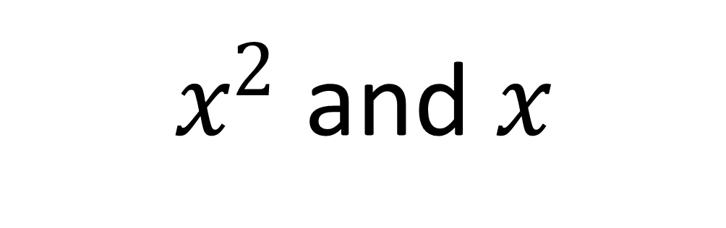
What is the highest common factor of .....
$x^{2}$ and $x$
2
$$x^{2}$$
A)
B)
$$x$$
1
C)
D)

Slide 15
What is the highest common factor of .....
38 and 57
19
38
A)
B)
18
16
C)
D)

Slide 16
Factorising Expressions
Factorising is the opposite of expansion.
It puts an expression back into brackets.
We have to find the Highest Common Factor
of all terms to factorise.
Expanding
Expanding
3(2t + 3m)
6t + 9m
4(5y + 2p)
20y + 8p
HCF = 3
HCF
= 4
Factorising
Factorising

Slide 17
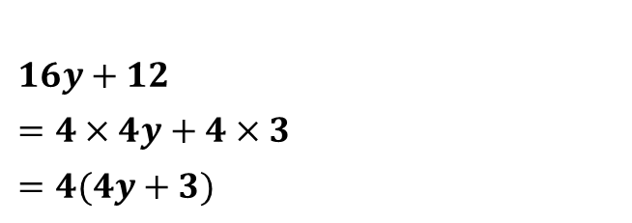
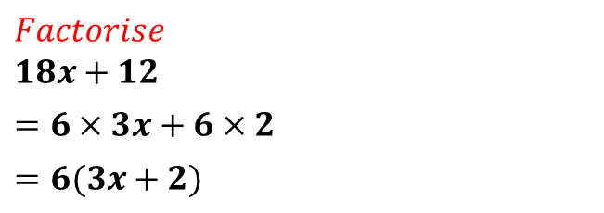
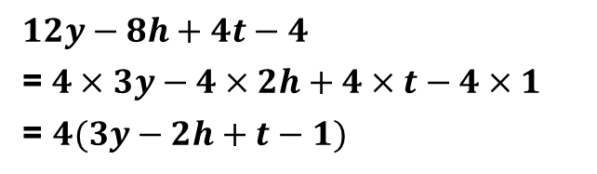
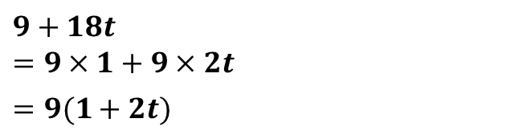
Look for highest common factor
Write terms as a product of factors using HCF
Take highest common factor to front of brackets.
$Factorise$
$18x+12$
$=6×3x+6×2$
$=6(3x+2)$
HCF = 6
$9+18t$
$=9×1+9×2t$
$=9(1+2t)$
HCF = 9
$16y+12$
$=4×4y+4×3$
$=4(4y+3)$
HCF = 4
$12y−8h+4t−4$
=$4×3y−4×2h+4×t−4×1$
= $4(3y−2h+t−1)$
HCF = 4

Slide 18
Individual task sheet

Slide 19
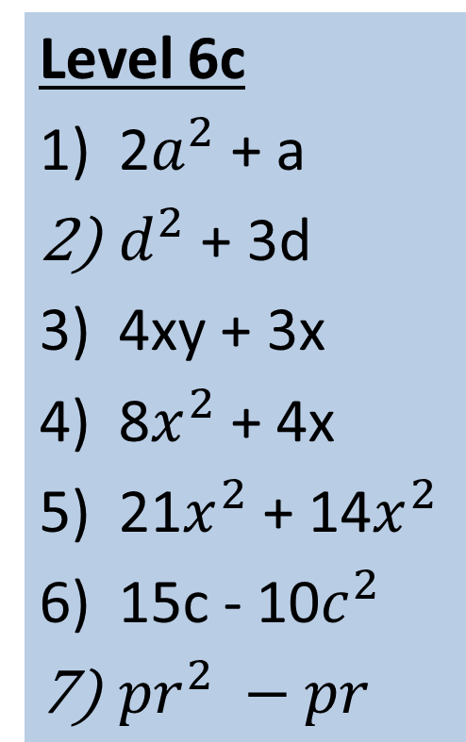
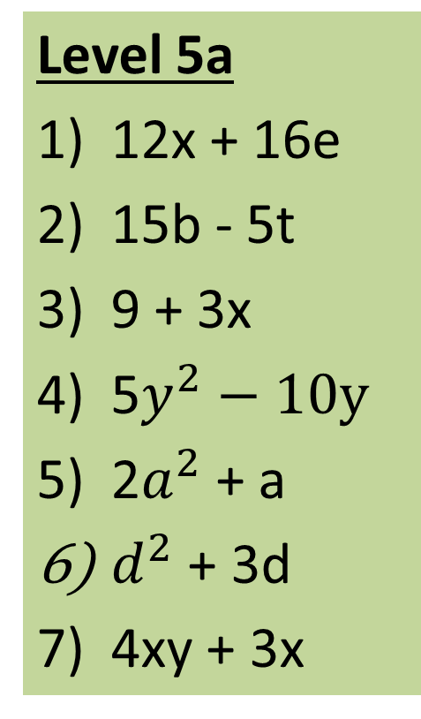
Activity 2 – Factorise the following:
Level 5b
2x + 6
4m + 12
16y + 10n
20p – 15r
15b – 5t
9 + 3x
12x + 16e
Level 5a
12x + 16e
15b - 5t
9 + 3x
5$y^{2}−10y$
2$a^{2}$ + a
$d^{2}$ + 3d
4xy + 3x
Level 6c
2$a^{2}$ + a
$d^{2}$ + 3d
4xy + 3x
8$x^{2}$ + 4x
21$x^{2}$ + 14$x^{2}$
15c - 10$c^{2}$
${pr}^{2} −pr$
10
9
8
6
5
3
2
1
7
4

Slide 20
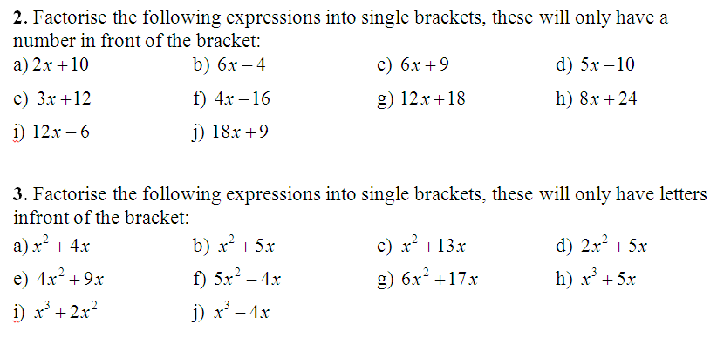
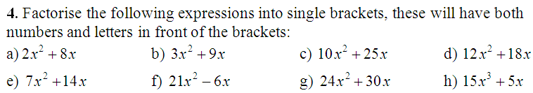
Activity 3
Extension:

Slide 21
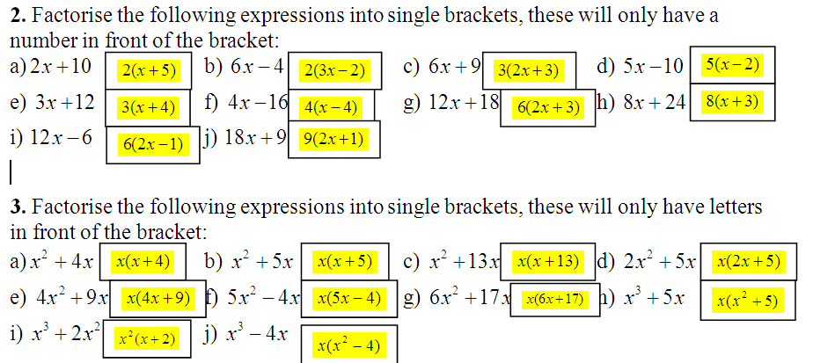
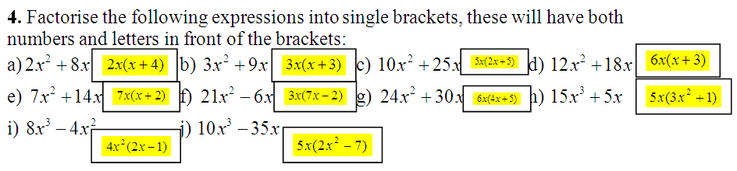
Answers to Activity 1

Slide 22
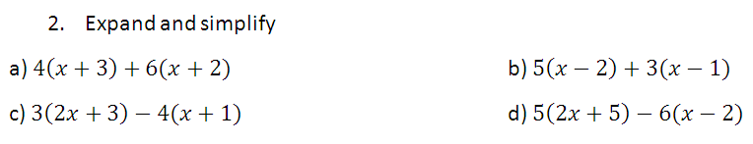
Extension

